Slide 1
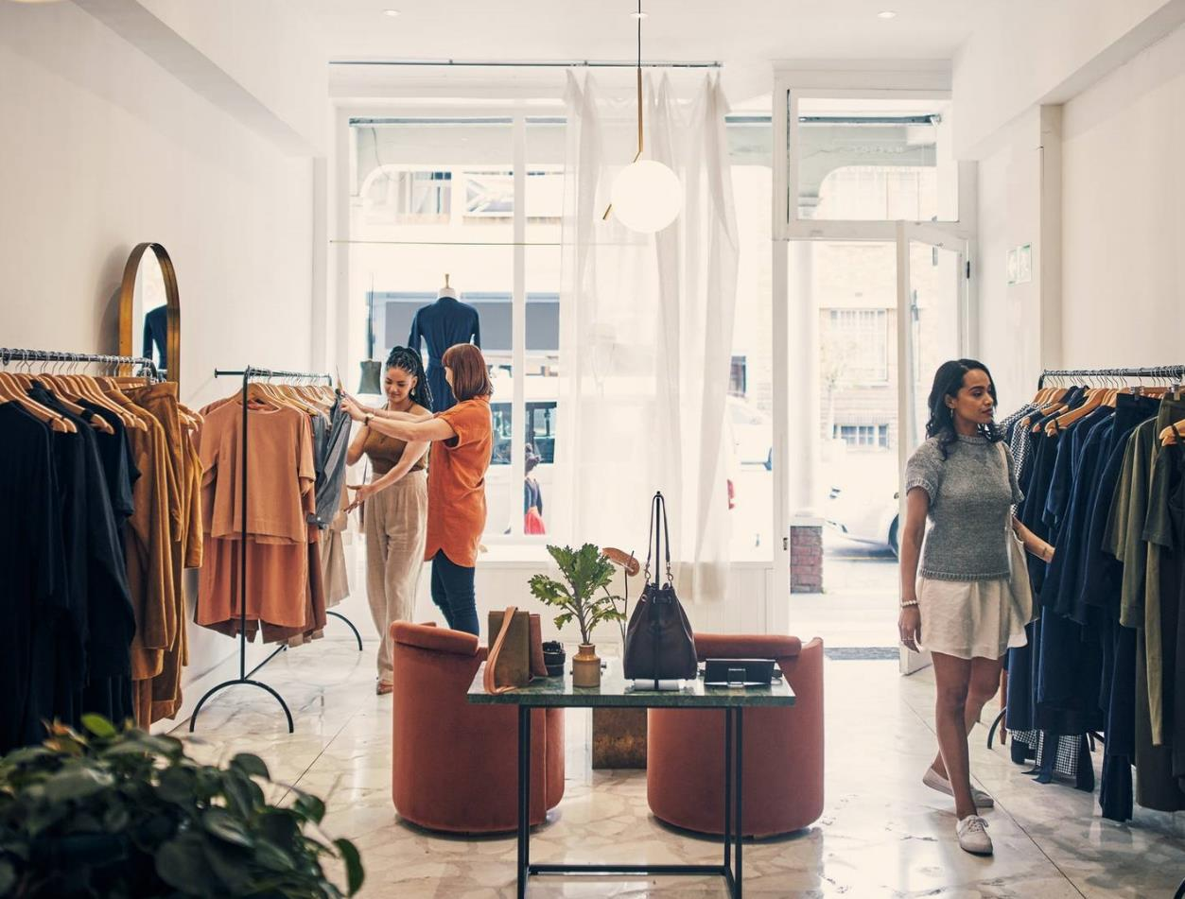
Tracking trending purchase patterns in Retail shopping

Slide 2
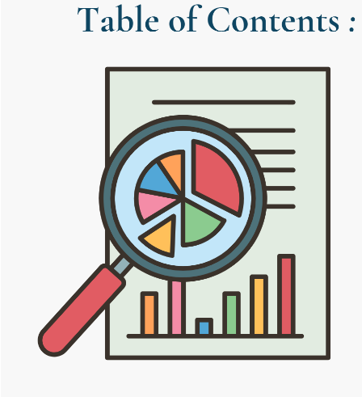
Introduction Objectives Data overview Analysis Conclusion suggestions

Slide 3
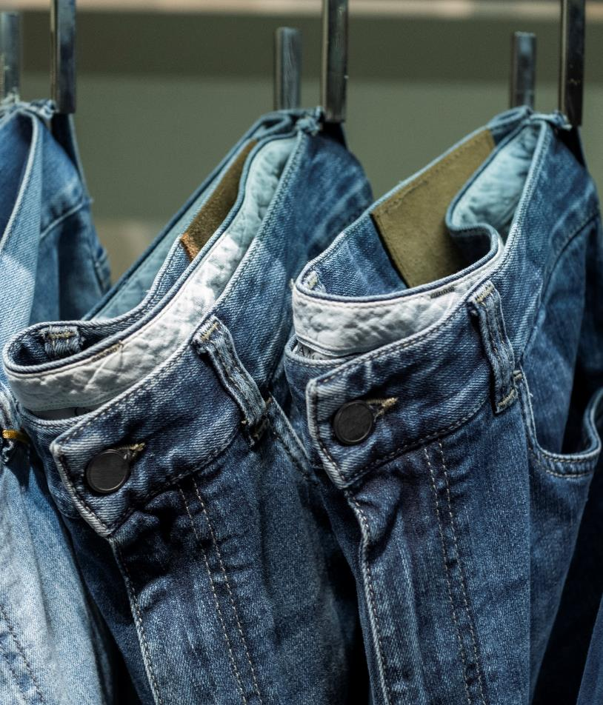
Introduction
In this presentation, we're going on a journey through retail sales data. Our goal? To find fascinating insights hidden in the numbers of items sold by stores.
s
we're delving into the wealth of retail sales data to uncover valuable insights that can empower retailers to make informed decisions and drive business success. By examining the trends and patterns in the items sold, we aim to shed light on the underlying factors shaping consumer preferences and purchasing behaviour.

Slide 4



Research objectives
Analyzing seasonal Trends and patterns
Examining the Influence of Reviews on Purchase Decisions
Exploring the Relationship Between Promo Codes and Purchase Amounts
1. Explore and interpret purchasing trends across different seasons to understand seasonal variations in customer behavior.
Investigate the relationship between product reviews and purchase amounts to determine the extent to which reviews influence buying decisions.
Examine the correlation between the usage of promo codes and the corresponding purchase amounts to asses the effectiveness of promotional strategies.

Slide 5
Data overview
Data description: The dataset comprises retail sales data, offering insights into sales activities across four distinct seasons: winter, summer, spring, and fall
Source of Data: This dataset was sourced from Kaggle, a renowned platform for data science and machine learning datasets and competitions.
Column Information: The dataset contains various columns providing details such as customer age, gender, purchased items, category, purchase amount (in USD), location, size, colour, season of purchase, review ratings, subscription status, shipping type, discount applied, promo code usage, previous purchases, payment method, and frequency of purchases.

Slide 6
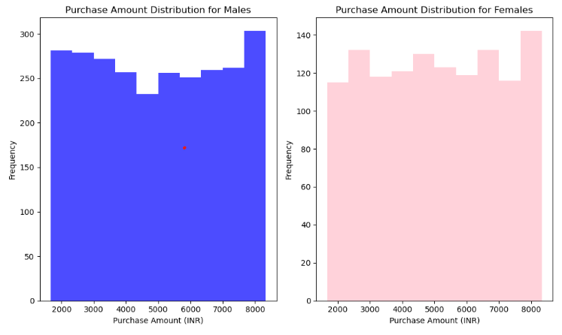
Analysis and findings
Among the customers purchasing products, approximately 68% are male, while the remaining 32% are female.
The mean amount spent by females is 5019.2, whereas males spend an average of 4959.8.
These findings suggest that although there's a higher proportion of male customers, females tend to spend slightly more on purchases.

Slide 7
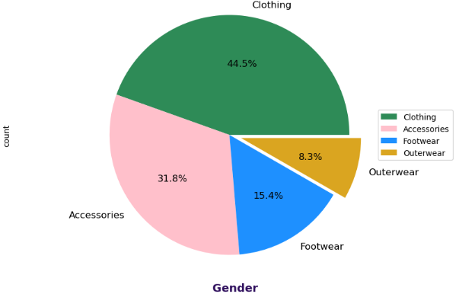
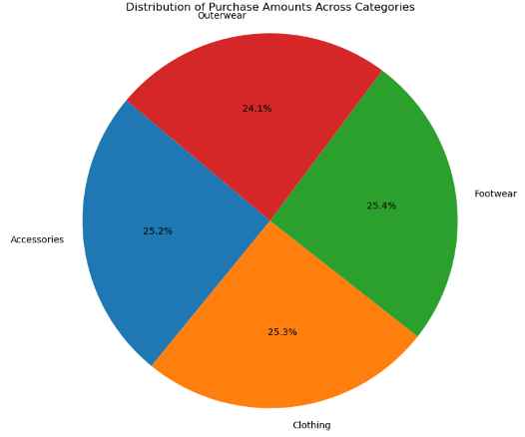
Customers are buying more clothes, but spending similar amounts per item across categories. This suggests they might be prioritizing quantity over price for clothing, possibly due to lower clothing prices or more frequent clothing purchases
Total quantity purchased in each category
Distribution of purchase amount across categories

Slide 8
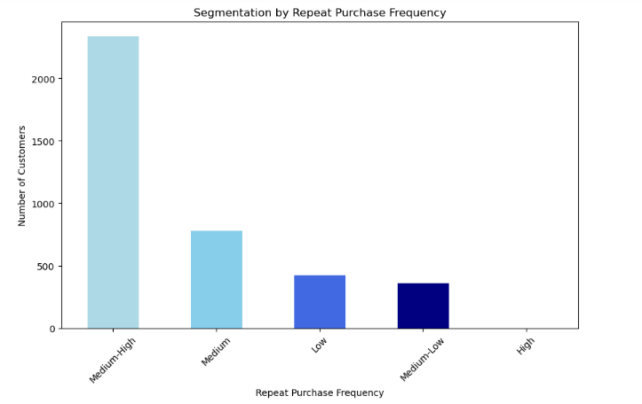
Customer Segmentation by Repeat Purchase Frequency
Medium-high repeat purchasers indicate high customer engagement, It suggests that a significant portion of customers is making repeated purchases, contributing to revenue stability and potentially higher customer lifetime value.

Slide 9
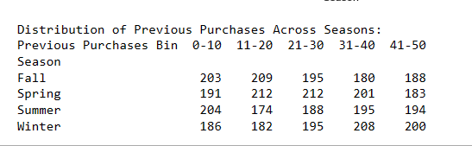
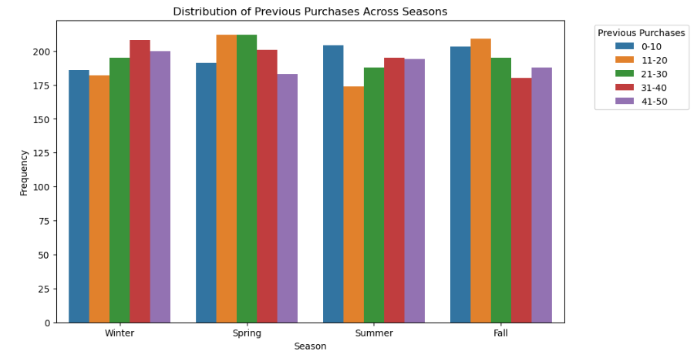
Seasonal Buying Trends: Distribution of Previous Purchases
Customers tend to purchase the most during Spring, with a total of 999 purchases across all purchase bins (0-10, 11-20, etc.), followed by Summer and then Fall and Winter but the difference with others is not so big so knowing the number of previous purchases made by a customer provides very little information about how much they are likely to spend on their next purchase.

Slide 10
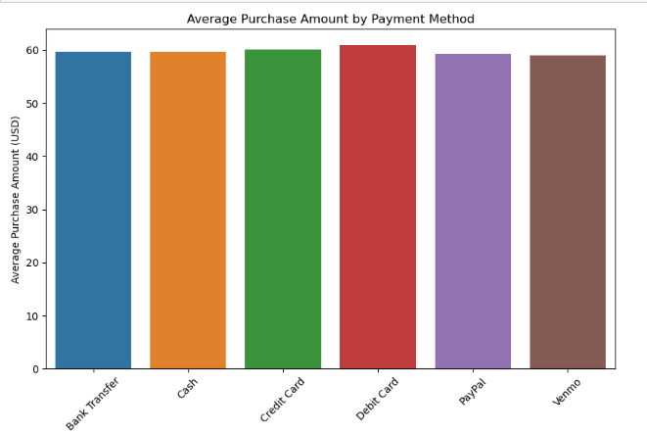
Analyzing that payment method affects purchase amount or not
The analysis indicates that the choice of payment method demonstrates minimal impact on the purchase amount.

Slide 11
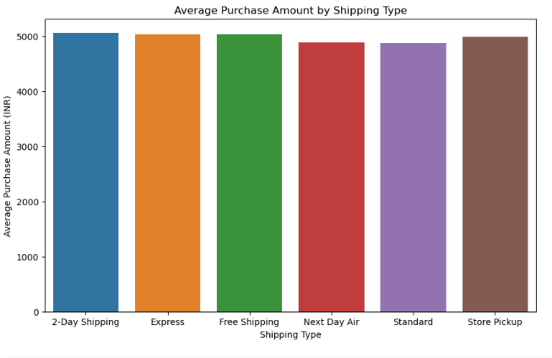
Analyzing that shipping type affects purchase amount or not
The analysis indicates that the choice of shipping type demonstrates minimal impact on the purchase amount.

Slide 12
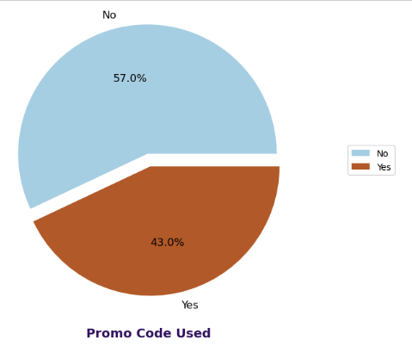
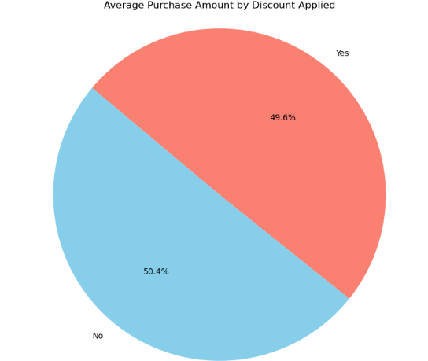
Analyzing the Impact of Discounts on Average Purchase Amount
The difference in average purchase amount between customers who receive discounts and those who do not is relatively small
Count of customers using promo code
Average purchase amount by discount applied

Slide 13
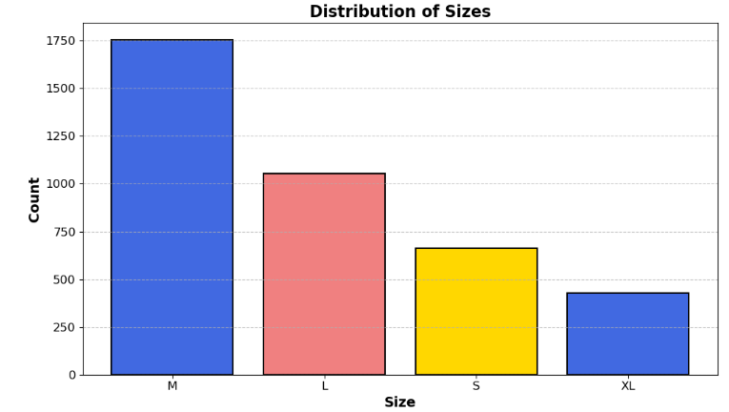
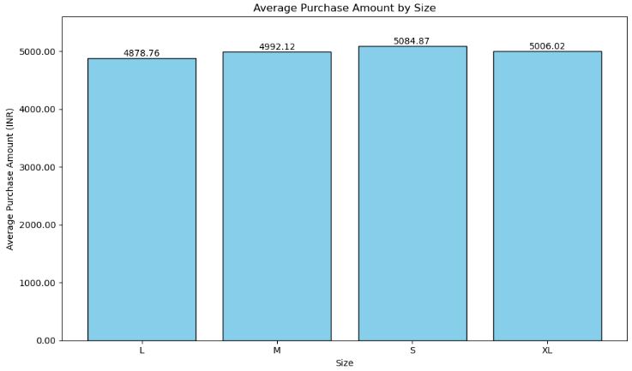
Analysis of Purchase Amount and Quantity Sold by Size
Small-sized items exhibit the highest average purchase amount among all size categories.
Despite the higher average purchase amount for small-sized items, the quantity sold is highest for
medium-sized items.

Slide 14
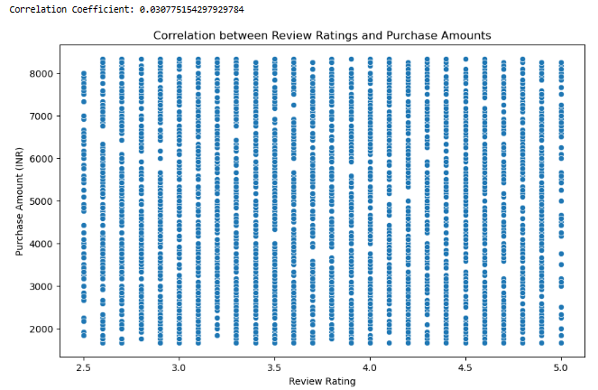
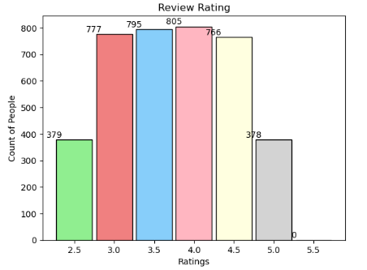
Exploring the Relationship Between Review Ratings and Purchase Amounts
A coefficient of 0.30 suggests a weak positive correlation, implying that higher review ratings are associated with slightly higher purchase amounts, but the relationship is not very strong.

Slide 15
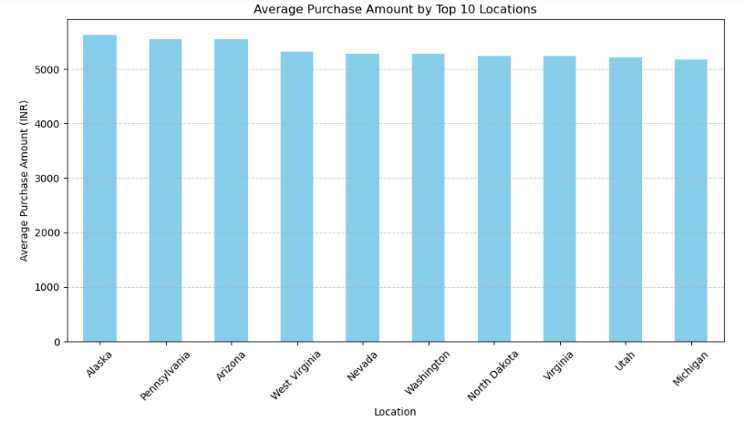
Decoding Purchase Power: A Look at Top Spending Locations

Slide 16
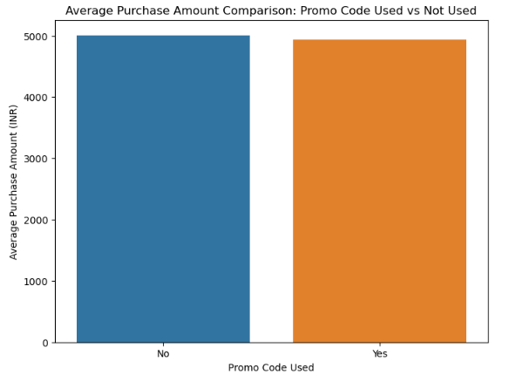
People who use promo codes spend less per purchase compared to those who don’t but the difference in the quantity of purchase amount is not so big.

Slide 17
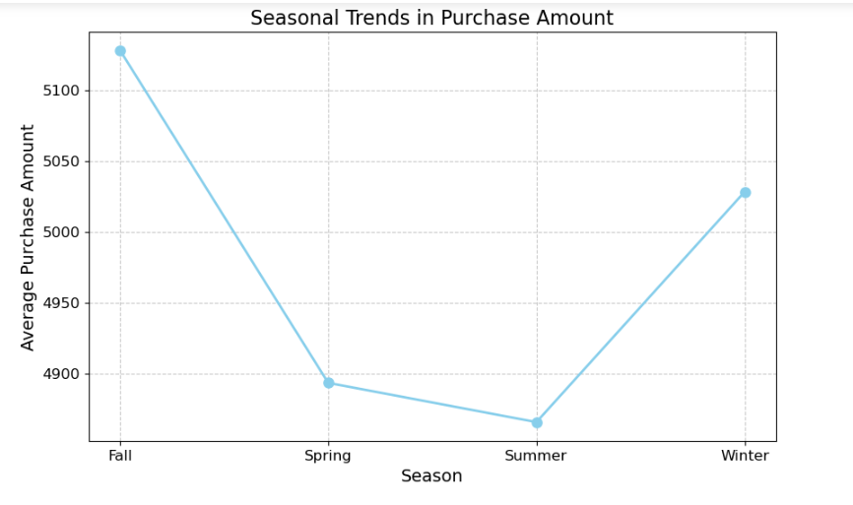
Trend analysis
Fall and Winter seasons tend to have higher average purchase amounts compared to Spring and Summer. Therefore, Fall and Winter could be considered as the best seasons for sales, as they attract higher spending from customers.

Slide 18
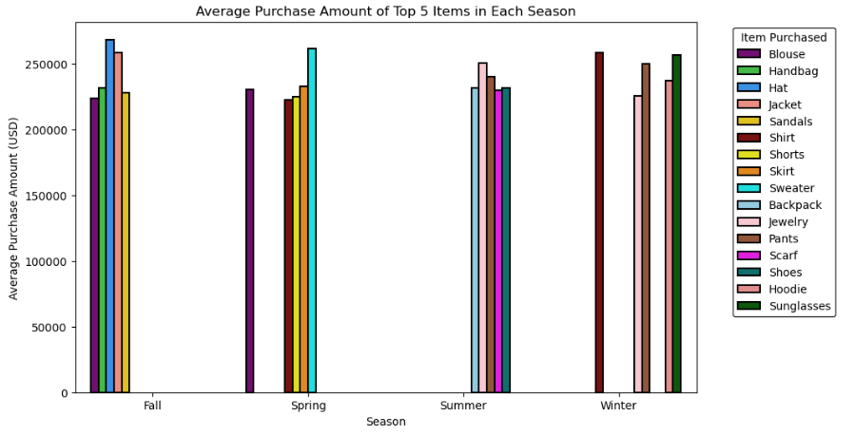
Fall is the season with the highest overall purchase amount, driven by expensive items like hats and jackets.
Most Expensive Items :Fall: Hat (₹268,583) and Jacket (₹258,750)

Slide 19
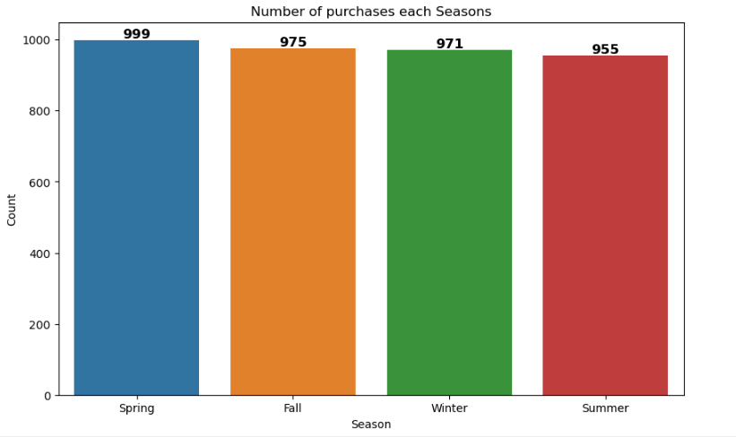
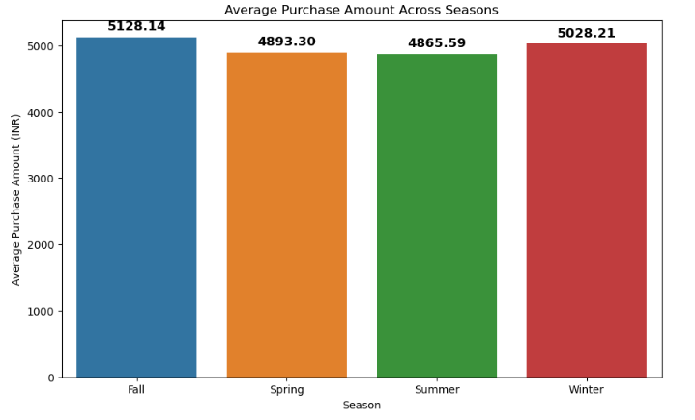
Seasonal Spending Patterns: Purchase Amount and Number of Items Purchased
Spring sees the most purchases, but Fall leads in total spending, likely due to expensive Fall items.

Slide 20

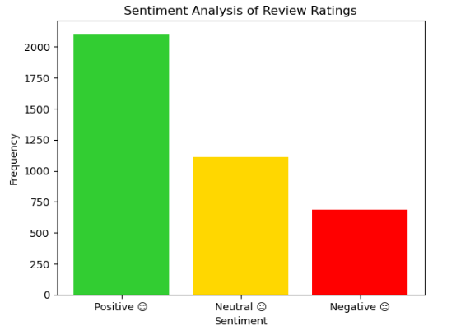
Sentimental Analysis
The analysis reveals a high degree of positive sentiment (58.09%), indicative of strong customer satisfaction with footwear products."
Investigate High Average Order Value: It's worth exploring why footwear contributes a high percentage of sales (25.4%) despite having a moderate customer base (15.4%). This could be due to factors like higher priced footwear items or customers buying multiple footwear products per order

Slide 21
conclusion
Among the purchasing customers, approximately 68% are male, with females comprising the remaining 32%. On average, females spend slightly more at 5019.2 compared to males, who spend an average of 4959.8.
Customers tend to purchase the most during Spring and Fall.
Payment method and shipping type show no significant effect on purchase amount, indicating customer preferences in these areas do not notably impact overall spending.
Although small-sized items demonstrate the highest average purchase amount, medium-sized items outsell them in quantity.
While blouse and jewelry witness high quantities sold, the average purchase amount is notably higher for hats and jackets.
The sentiment analysis indicates that footwear products receive the highest level of positive sentiment among customers. This suggests that footwear items are well-received and positively perceived by customers, potentially indicating a strong preference or satisfaction with this category of products.

Slide 22
Suggestion
Implement targeted marketing strategies towards female customers, considering they contribute approximately 32% of purchases but tend to invest slightly more, accounting for about 52% of total purchase value
Introduce premium or higher-priced clothing options to increase the average purchase amount per item. This could potentially lead to a revenue increase of up to 15%.
As customers tend to spend more during Fall and Spring, it's advisable to introduce high-profitable products during these seasons and implement targeted marketing campaigns to capitalize on increased consumer spending. This strategy may result in a sales boost of approximately 20%.
Offer competitive pricing and attractive deals for medium-sized items, as they account for about 40% of total purchases. Aligning pricing strategies with customer preferences could lead to an increase in sales by around 10%.
Implement targeted pricing strategies or promotional offers for products with higher average purchase values, such as hats and jackets. Exploring discounts or bundle deals on these items may incentivise more purchases and potentially increase revenue by up to 25%.

Slide 24
Key Recommen-dations for Enhanced Profitability
Implement targeted promotions or discounts on clothing items, offering up to 15% off selected items to boost spending
Introduce high-profitable products during Fall and Spring seasons with dedicated marketing campaigns, allocating 20% of the marketing budget for maximum impact
Enhance post-rating feedback mechanisms with personalized follow-up emails to address concerns, potentially improving sentiment ratings by 15% and boosting customer loyalty

Slide 25
Growth strategy
How we’ll scale in the future
January
February
March
April
May
June
Fall season- Engage customers through personalized experiences and excellent service.Offer promotions, discounts, and sales events to attract and retain customers, utilizing multi-channel marketing strategies to reach a broader audience.
Diversify Product Offerings: Expand product range beyond seasonal items to include complementary products or tap into niche markets, maintaining revenue and attracting customers .
July
August
September
October
November
December
Spring season- Prioritize stocking trendy and seasonally appropriate clothing, accessories, footwear, and outerwear.Highlight key items such as sweaters, jackets, scarves, and boots to meet customer demand for transitional wardrobe pieces.

Slide 26



My project ,Blog ,contract details
susmitapoddar1704@gmail.com
Click here
Click here

Slide 27
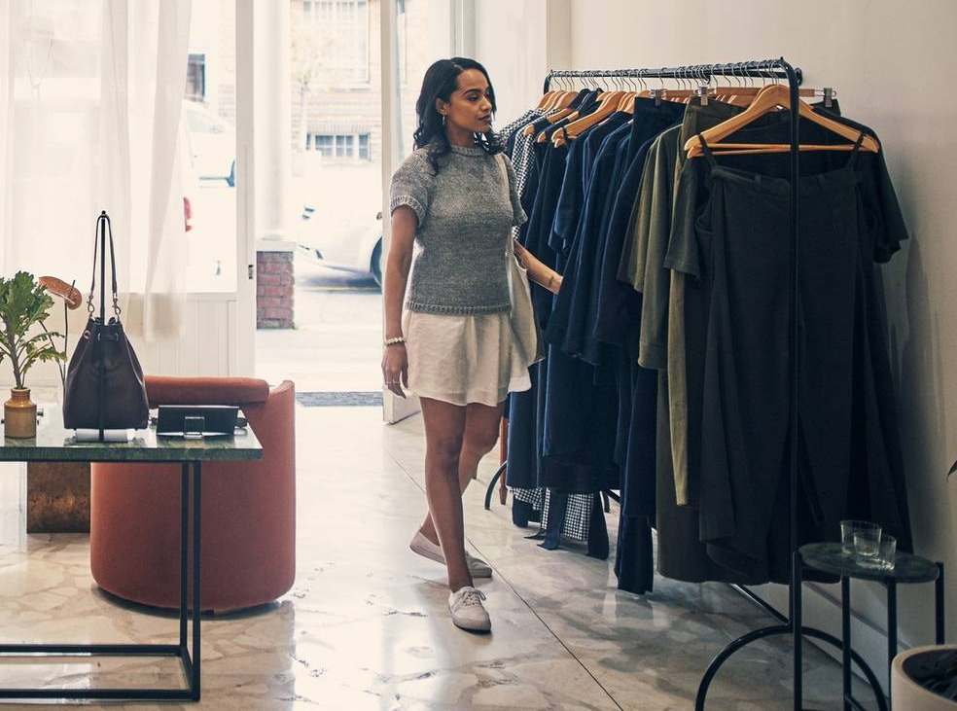
Thank you
WE HELP BUSINESSES GROW AND NURTURE A CONSUMER-FIRST MINDSET.
Susmita poddar​
206-555-0146
mirjam@contoso.com
www.contoso.com

